Slide 1
Vibes&
Happenings
An event management system

Slide 2
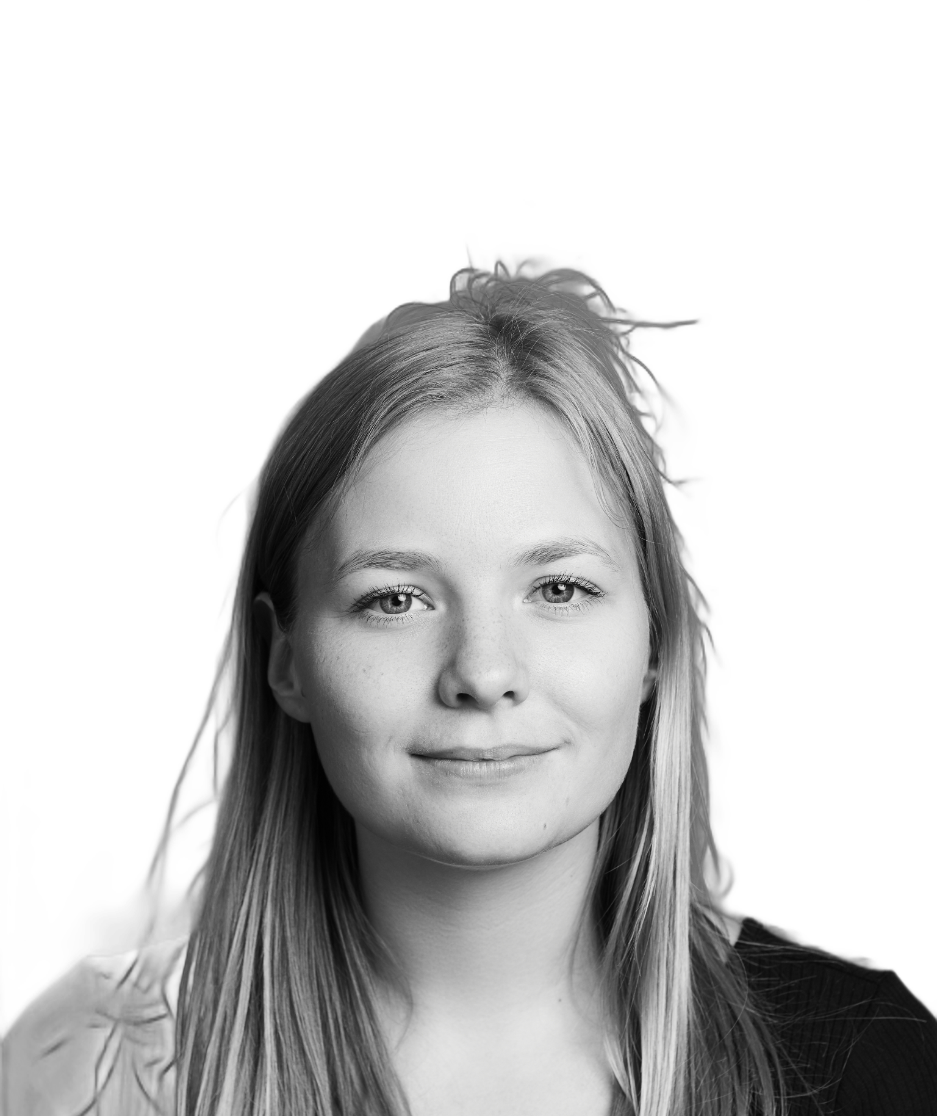
HELLO! I’m…
Mickaela Södergren
28 years old
From Sweden, now living in Denmark
Work experience: +3 years
Current title: Frontend developer & UI/UX Designer

Slide 3
TABLE OF CONTENTS.
Demo
Time management
Design & Code
Reflections
01
02
A live demonstration
How my time was spent on the project
03
04
Looking at the design and architecture choices
Limitations and excuses

Slide 4
Demo
01
(Let’s pray to the demo gods)

Slide 5
Time Management
Project setup Eslint, prettier, tsconfig, vscode settings, github repository etc.
Functionality Adding mapping, typing, utils and functions
~1.5h
~1.5h
Total: ~6 h
Mockup
Choosing a color scheme and creating a Figma draft
Architecture & UI components
Deciding on a folder structure and implementing the components w/o functionality
~1h
~2h

Slide 6
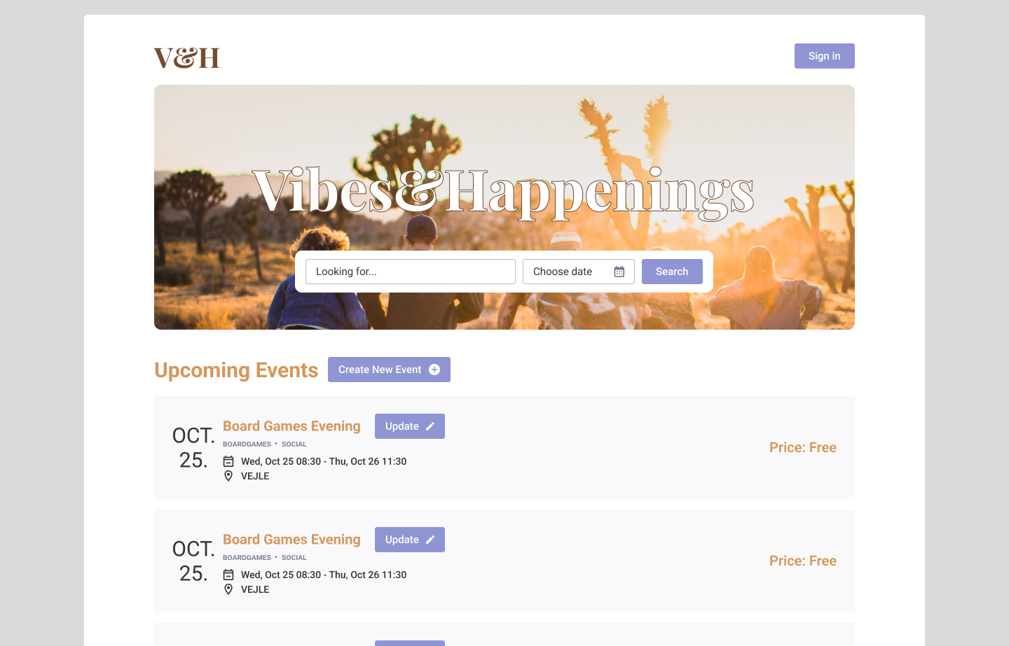

Figma design
Color palette: https://coolors.co/
Close to pixel perfect
Time constraint -> Figma is faster

Slide 7
Architecture
src/
├─ components/
├─ context/
├─ domain/
├─ extensions/
├─ mapping/
├─ utils/
├─ assets/
├─ apollo/
│ ├─ queries/
Application size/complexity
Example: Atomic Design felt a bit overkill
State management
Context & Session Storage
Consider needed components based on design
Rick & Morty API (GraphQL)

Slide 8
Architecture
src/
├─ components/
├─ context/
├─ domain/
├─ extensions/
├─ mapping/
├─ utils/
├─ assets/
├─ apollo/
│ ├─ queries/
Libraries used
MUI
Emotions styled
Faker
Apollo

Slide 9
Reflection
Leaving part of the application unfinished
Requirements > nice to have’s
Search & Filtering [time constraint]
Sign in [stubbed]
Choice of API
Using faker to make it more real.
Application issues
Creating a new event puts it at the bottom, despite the start date
ERROR: A component is changing an uncontrolled input to be controlled
Start date and End date not validated
Real life scenario
Talk with stakeholder(s)

Slide 10
THANK YOU!
Do you have any questions?

Slide 11
CREDITS.
Presentation Template: SlidesMania
Sample Images: Unsplash
Fonts used in this presentation: Lexend and Belanosima.

